Slide 1





BRAIN TUMOR DETECTION
Daniela Gvazava, Nino Tkemaladze

Slide 2
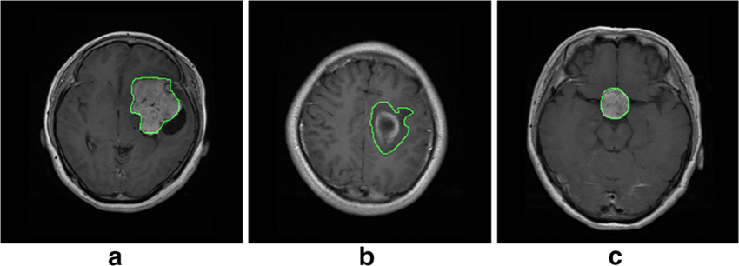
PROBLEM DEFINITION
Over 300, 000 brain tumor diagnoses globally each year
5-year survival rate: 36% on average
Early detection:
Increases survival chances
Cuts treatment costs by 30-50 %
Multi-class classification problem – Predicting tumor type
a) Meningioma
b) Glioma
c) Pituitary
No tumor

Slide 3
THE PROBLEM WITH MANUAL DIAGNOSIS:
Takes 15–30 minutes per patient to analyze the MRI scan
Prone to exhaustion and human error
Error rates:
- Daily: 3–5%
- Complex cases: up to 30%
Global impact:
- 1 billion+ scans/year
- 4% error rate = 40 million mistakes
- Low-value imaging wastes billions yearly

Slide 4
WHY DEEP LEARNING IS A GAME CHANGER:
CNNs analyze hundreds of images in seconds
Achieve 90–95%+ accuracy, rivaling experts
Once trained, cost is near zero per scan
Saves time, reduces false diagnoses, scales globally
Assists radiologists as a second opinion system
Reduces Type I and Type II errors

Slide 5
DATA PROCESSING
DATA AUGMENTATION
DATA TRANSFORMATION
Random rotation (±15°)
Horizontal and vertical flip
Resize
ResNet18's expected input size
Balances the trade-off between efficient training and picture quality
Transformed into grayscale images
Normalized for faster convergence
Prevents overfitting
Improves generalization
Acts like regularization
Introduces variability

Slide 6
MODEL ARCHITECTURE
REGULAR CNN
RESNET
Input MRI
↓
Conv Block 1 (32 filters)
↓
Conv Block 2 (64 filters)
↓
Conv Block 3 (128 filters)
↓
Conv Block 4 (256 filters)
↓
FC Layers
↓
4-Class Output
Input MRI
↓
Modified Conv1 (1→64 channels)
↓
ResNet-18 Blocks (with skip connections)
↓
Global Average Pooling
↓
Modified FC Layer (→4 classes)
↓
4-Class Output

Slide 7
OPTIMIZATION
LOSS FUNCTION
OPTIMIZER
Cross-Entropy Loss is used for multi-class classification
Adam combines Momentum and RMSProp, which use momentum terms and adaptive learning rates
Learning rate scheduler is used for validation loss plateaus

Slide 8
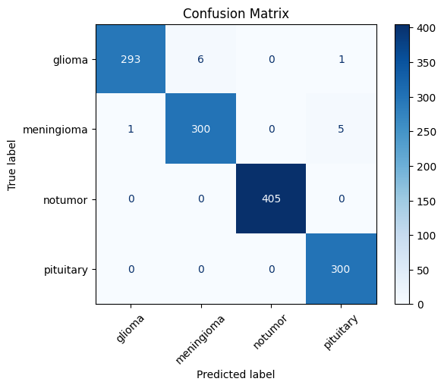
RESULTS
Final Test Accuracy: 99.02%
Train Accuracy: 98.63%
Per-class accuracies:
glioma: 97.74%
meningioma: 98.10%
pituitary_tumor: 100.00%
no_tumor: 100.00%

Slide 9
CONCLUSION
Developed a deep learning model for brain tumor classification
Processes MRI scans in seconds with expert-level accuracy
Enables faster, earlier, and more reliable diagnosis
Distinguishes tumor types → supports personalized treatment
Valuable in high-load or low-resource medical settings

Slide 10
THANK YOU
APP

